Slide 1
NODE.JS
(The Backend Of MERN Stack)
Lecture 26

Slide 2
Today’s Agenda
Using Placeholders
Inserting New Record
Updating Record
Deleting Records
Exercises

Slide 3
Exercise 61
Write an Expresss-application to handle the api call GET : /api/employees/:id and return the record of that employee as a JSON object , whose id is passed as route parameter.
In case given employee is not found then return a JSON object acknowledging the same.
In case of any exception during query processing return the error code 500 with the DB error message.

Slide 4
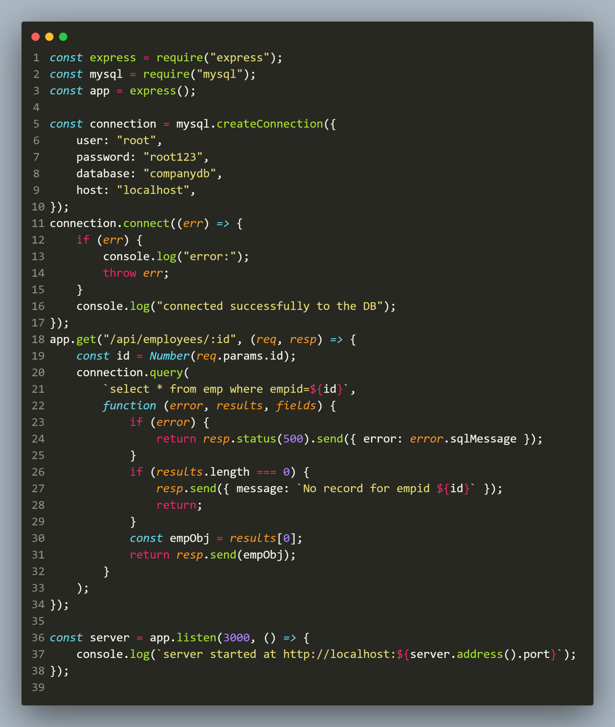
solution

Slide 5
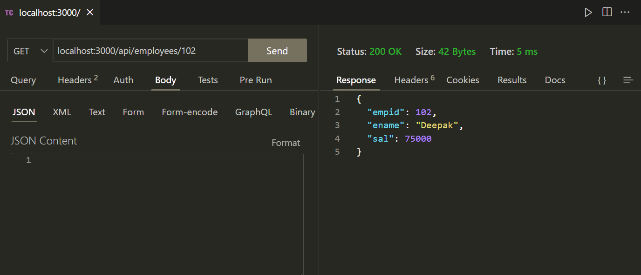
output

Slide 6
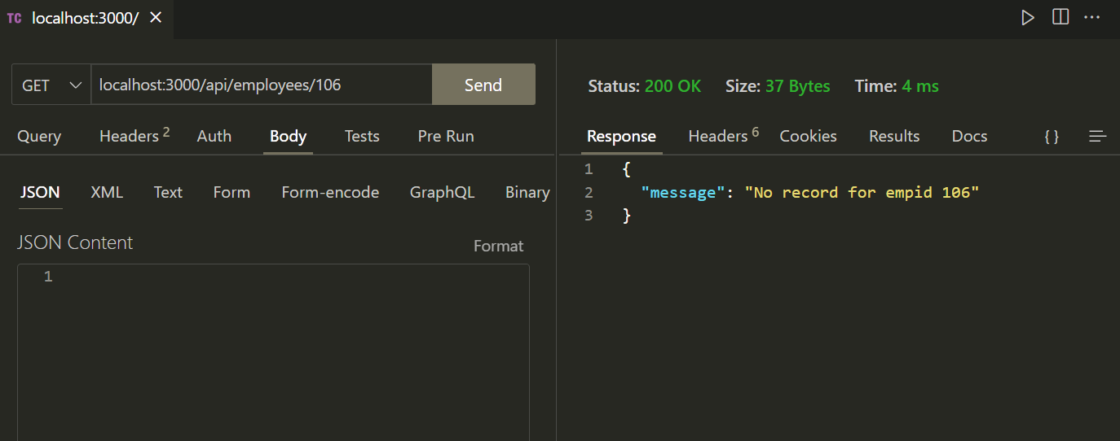
output

Slide 7
Problem with the previous code
Although the previous code works but it can suffer from a very popular attack called SQL Injection.
An SQL injection attack happens when a user injects malicious bits of SQL into our database queries.

Slide 8
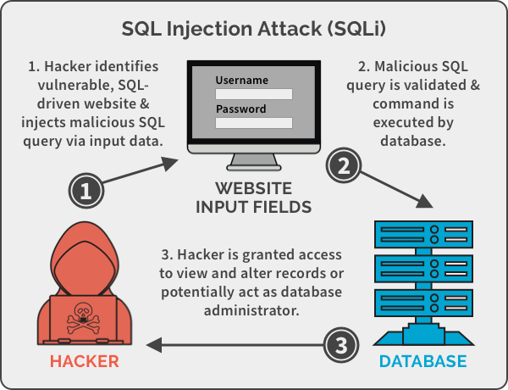
Problem with the previous code

Slide 9
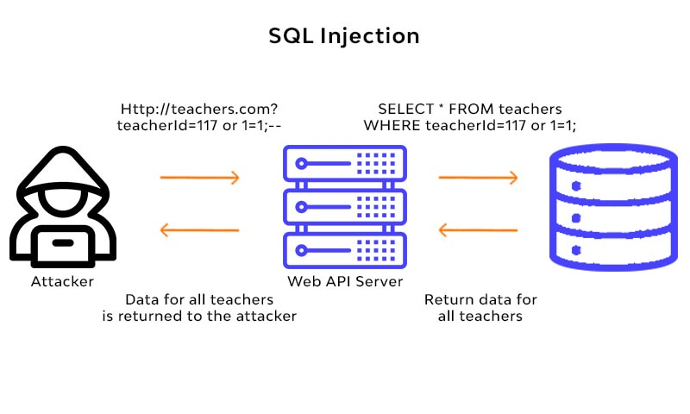
Problem with the previous code

Slide 10
Problem with the previous code
By injecting their own SQL, the user can cause harm by:
reading sensitive data
modifying sensitive data
Thus we should never accept raw input from a user and input it directly into our query string.
Instead, we should use placeholders (?)

Slide 11
What are Placeholders ?
A placeholder is simply ‘?’ and it goes in the SQL query in place of a yet-to-be-supplied value.
The program is then expected to replace that ‘?’ with a value that is supplied at run time by user or any other source.

Slide 12
What are Placeholders ?
In simple words, a placeholder allows us to bind parameters with values in an SQL query.
And by using placeholders, the malicious SQL will be escaped and treated as a raw string, not as actual SQL code.

Slide 13
How to use placeholders ?
To use a placeholder we take 2 steps:
Apply the symbol of ? in the SQL query passed to the query() method wherever we want to add the dynamic value.
Pass a second argument to the query() method which will be an array containing the value/variable to be used in place of question mark.
At run time the placeholders will be replaced with the values passed in the array as per their order.

Slide 14
Exercise 62
Rewrite the previous code using placeholders.

Slide 15
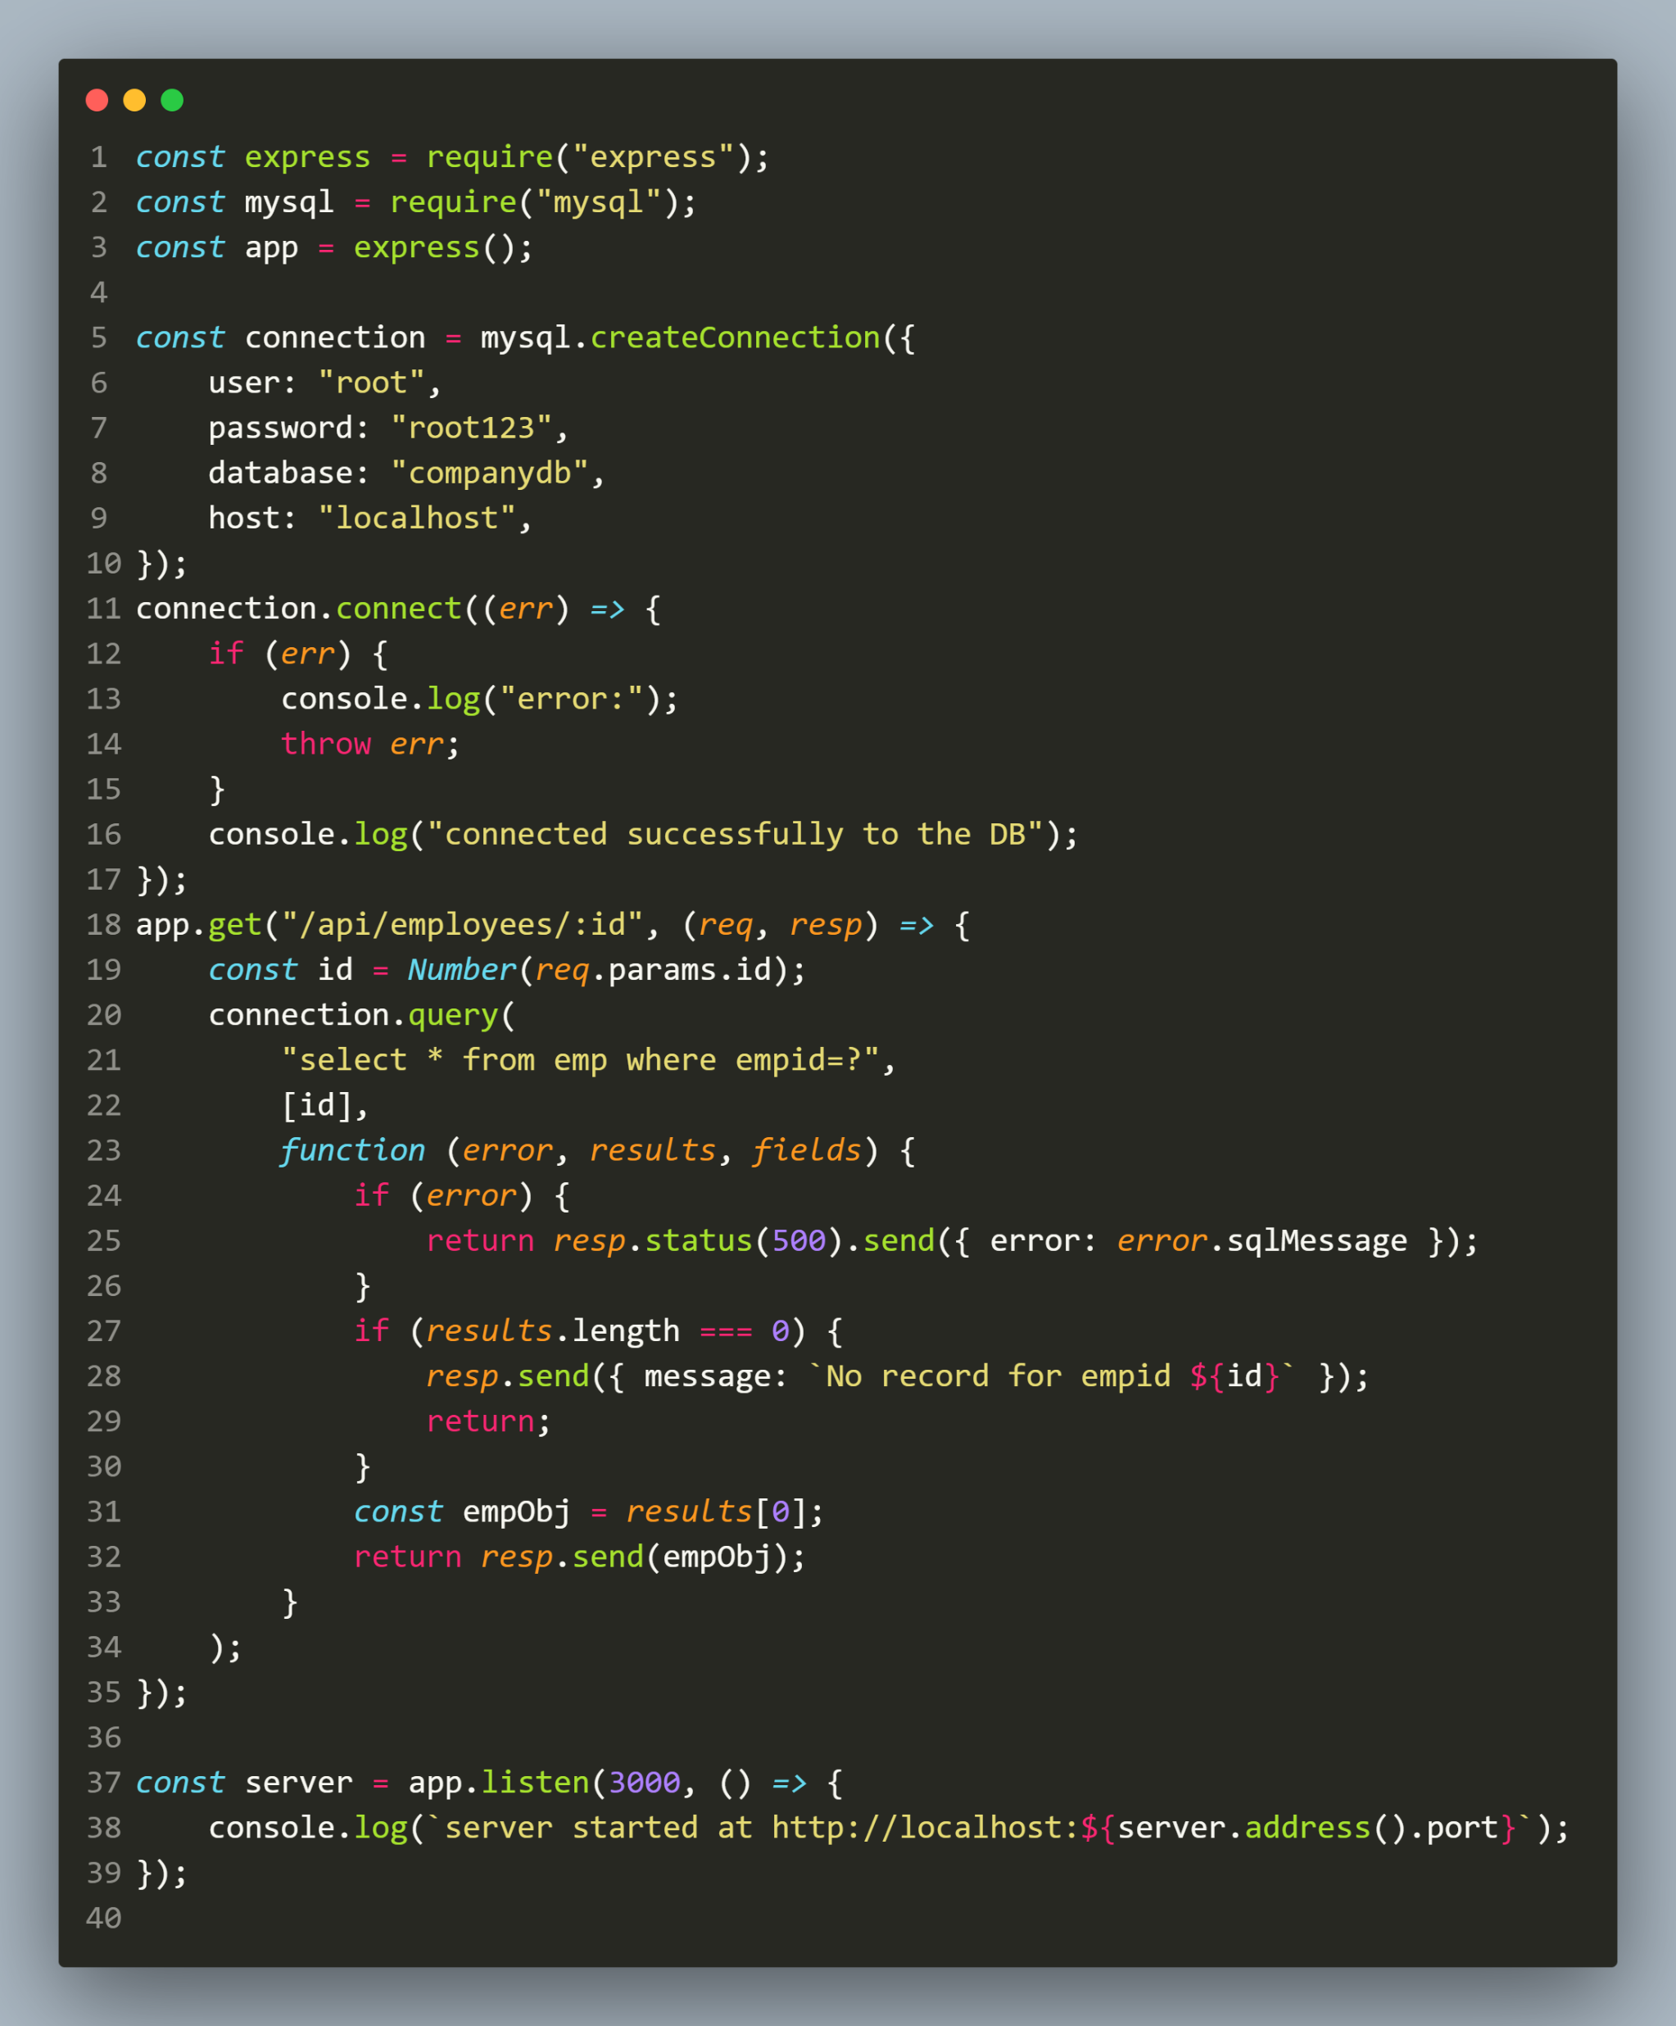
solution

Slide 16
output

Slide 17
output

Slide 18
Exercise 63
Write an Expresss-EJS application to handle the api call GET : /api/employees with a given range of salary and return the records of those employees who earn within that range.
In case no employee is found in that range then return a JSON object acknowledging the same.
In case of any exception during query processing return the error code 500 with the DB error message.

Slide 19
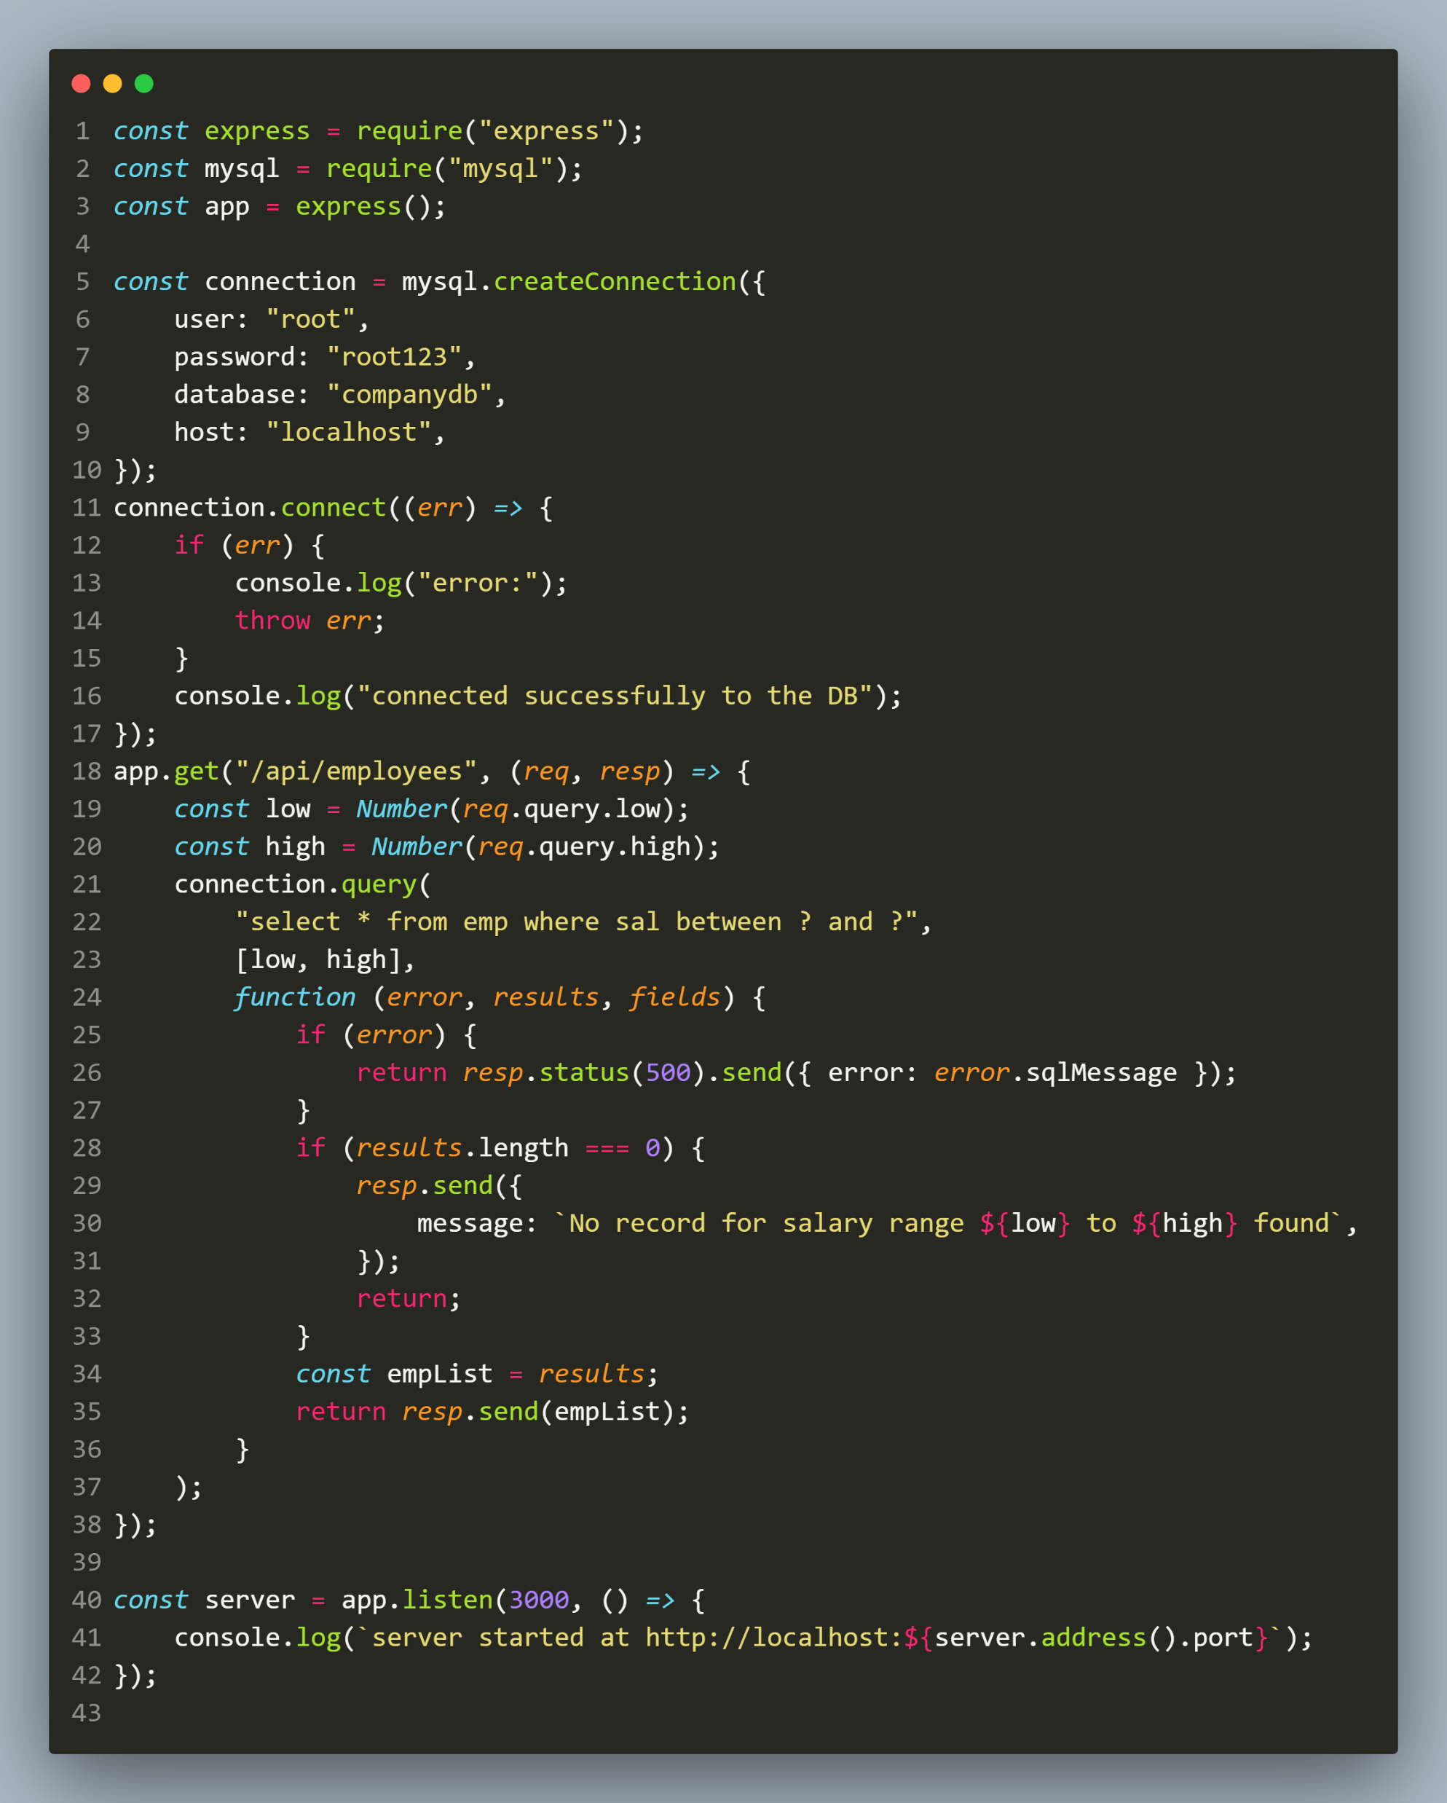
solution

Slide 20
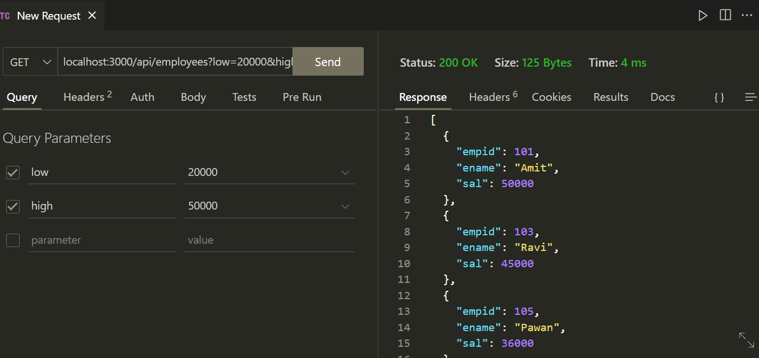
output

Slide 21
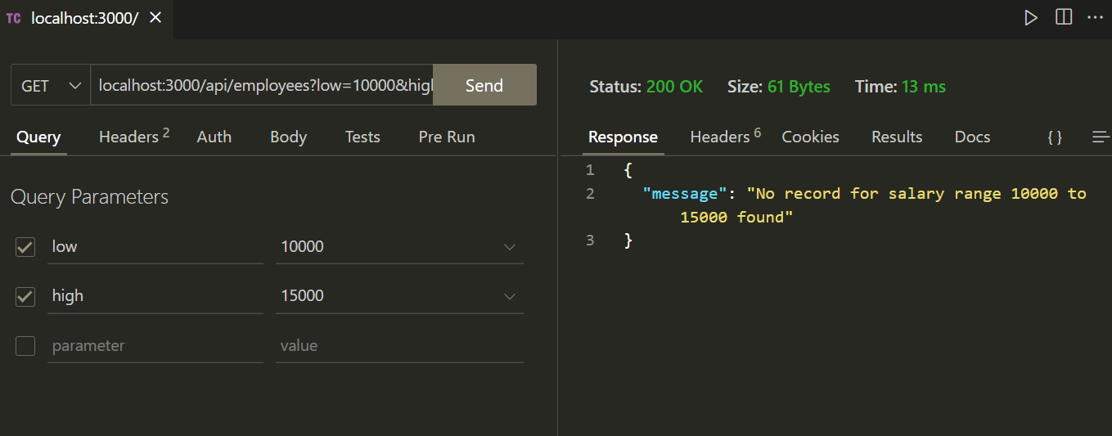
output

Slide 22
inserting record
The steps to insert a new record are same as selecting a record.
Here also if the values are dynamic then we can use placeholders.

Slide 23
inserting record
However as a result we do not get a RowDataPacket object , rather we get a normal JS object with some key-value pairs .
The most useful is the affectedRows property which returns total number of rows effected

Slide 24
Exercise 64
Write an Expresss-EJS application for inserting an employee as follows:
Your application should accept employee id, employee name and employee salary through a POST request and insert a new record in the Emp table.
Finally it should return a JSON object containing the message Emp added and the empid of the employee.

Slide 25
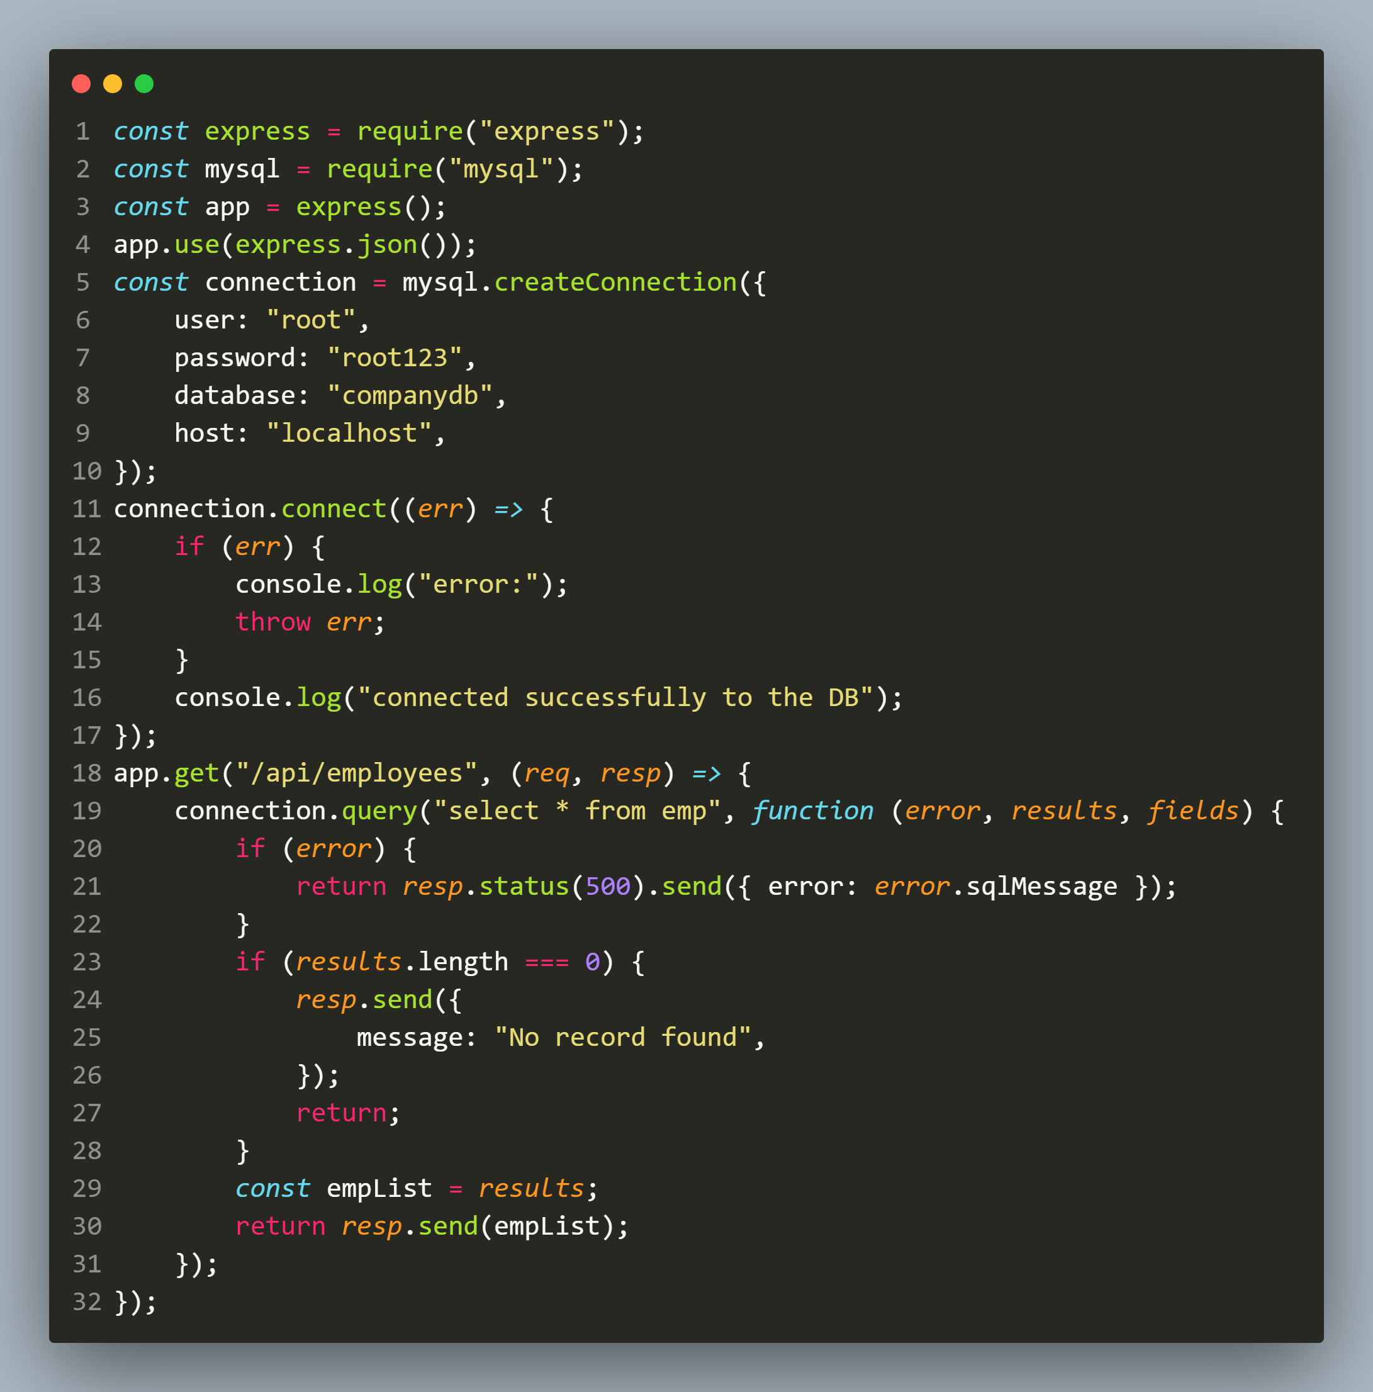
solution

Slide 26
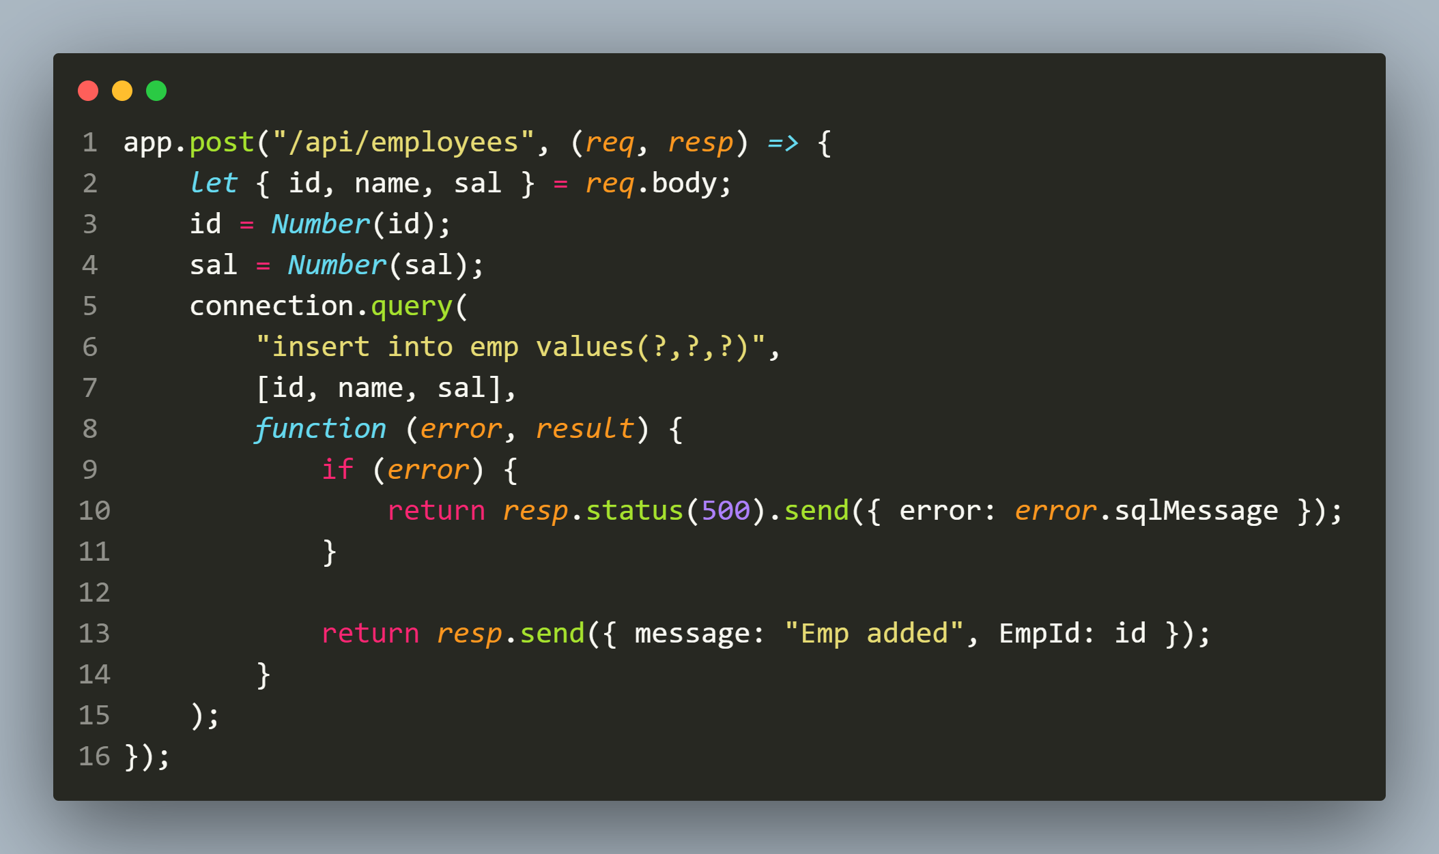
solution

Slide 27
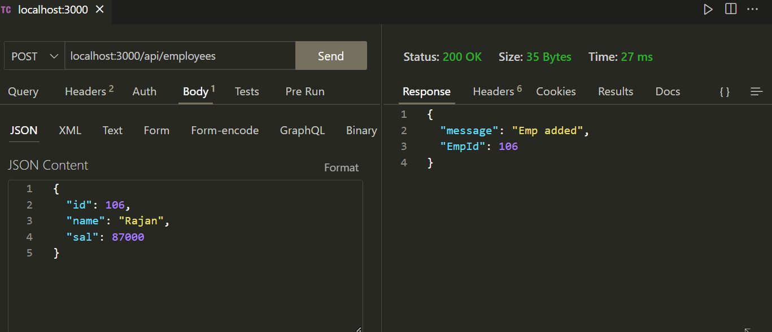
output

Slide 28
Exercise 65
Write an HTML-Form based Expresss-EJS DB application to do the following:
For the request : http://localhost:3000/employees , display a table containing all the records as well as total record count at the top.
Allow the user to add a new Emp but id should be generated automatically.
On successful addition of employee to the DB display a success page
On any error display an error page

Slide 29
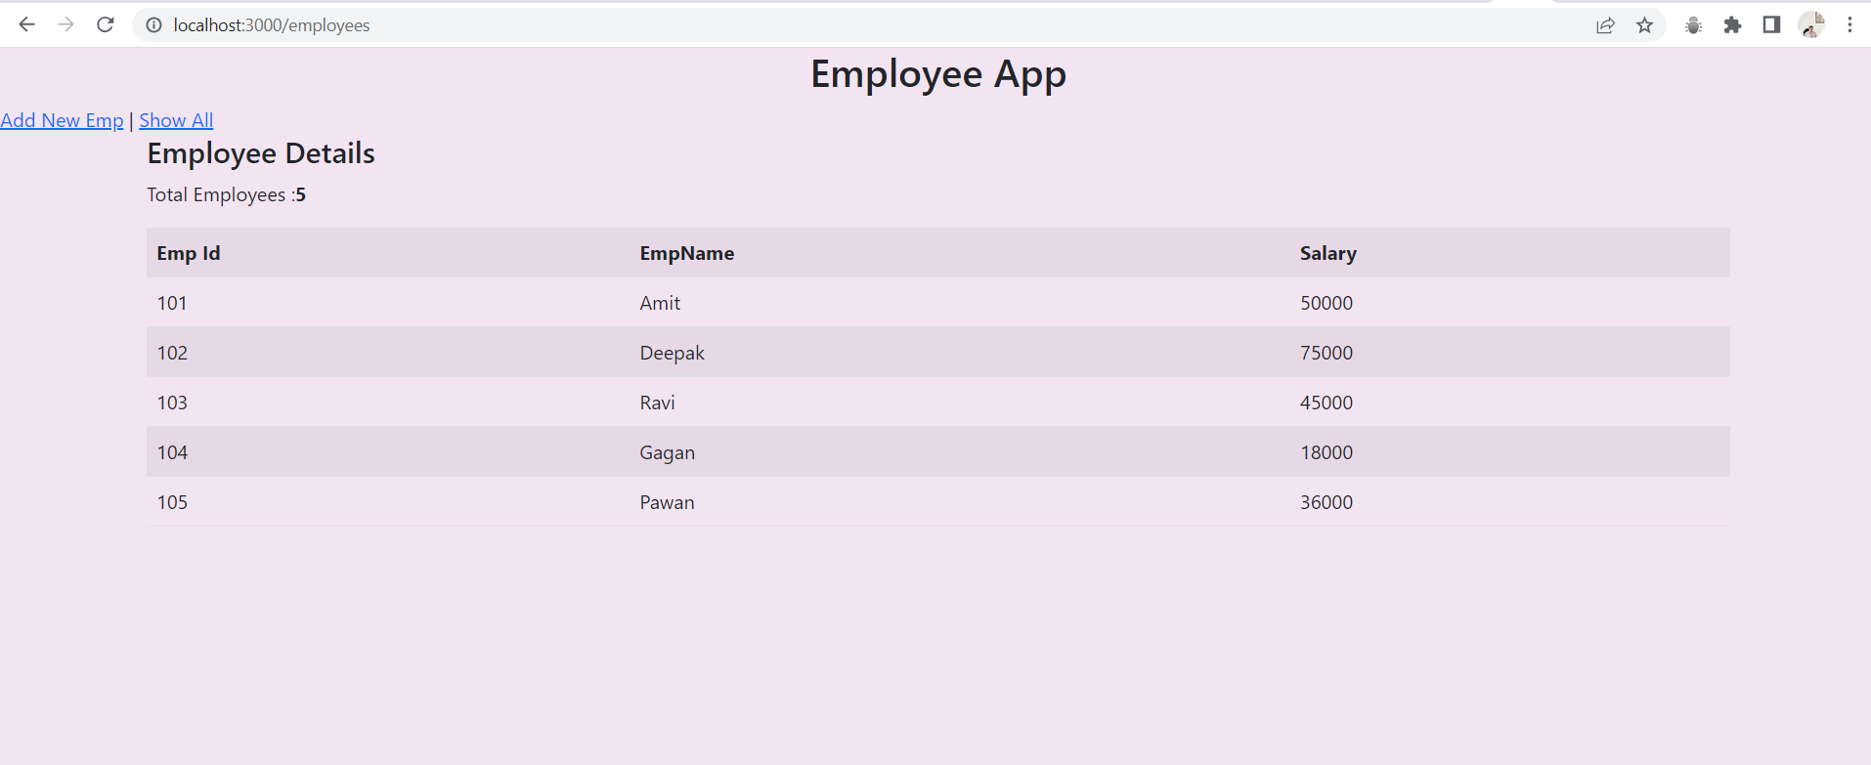
output

Slide 30
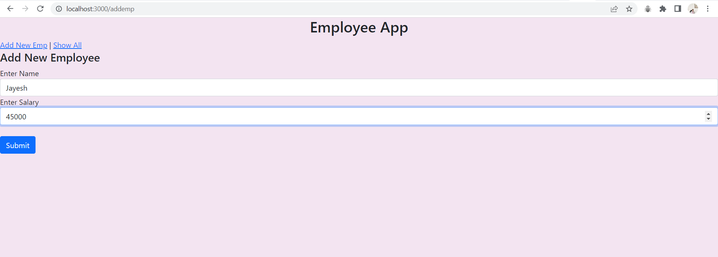
output

Slide 31
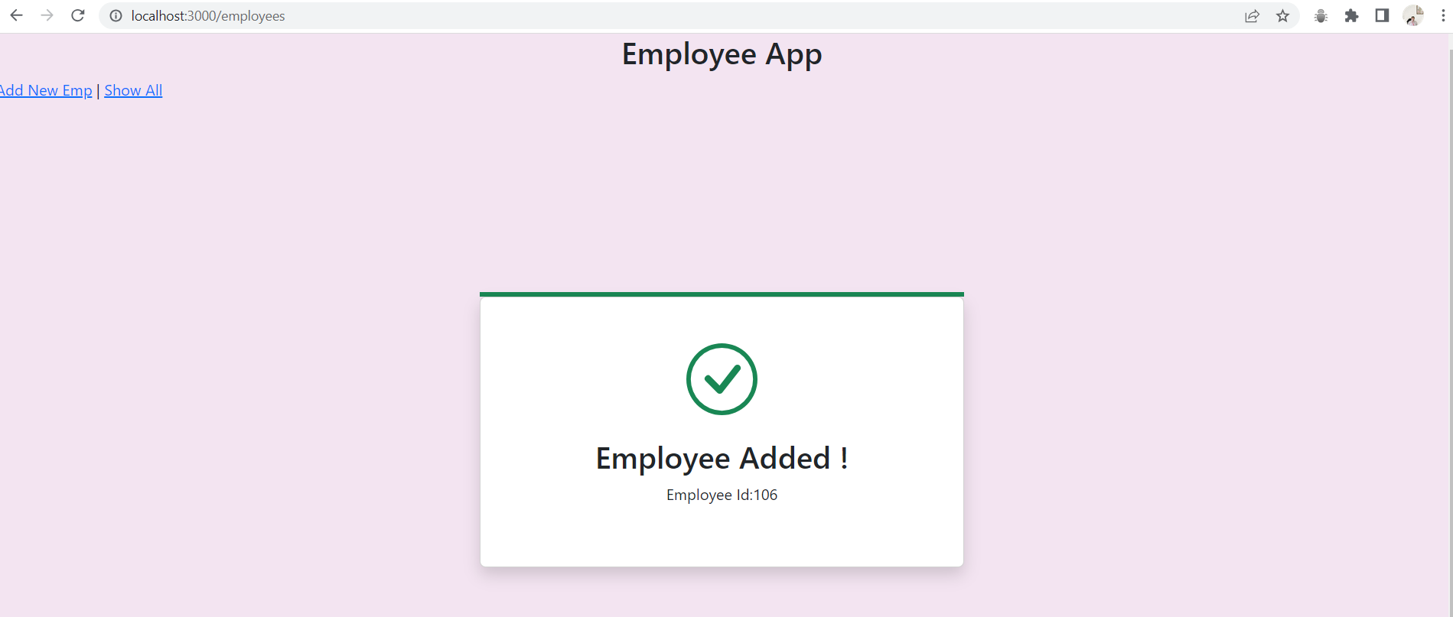
output

Slide 32
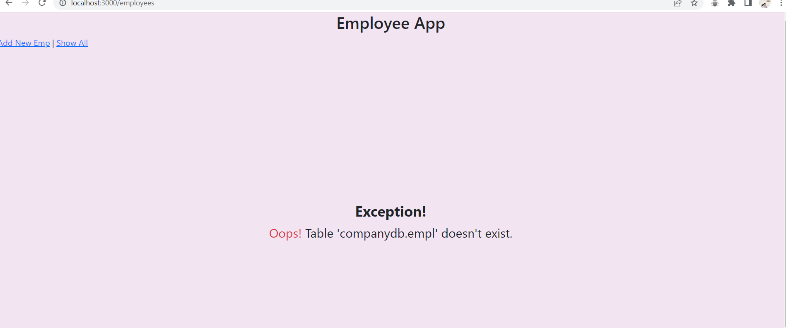
output

Slide 33
updating record
The steps to update a record are same as inserting a new record.
Here also if the values are dynamic then we can use placeholders.
To obtain number of rows effected we can use the affectedRows property of the object we get back as a response from db.

Slide 34
Exercise 66
Write an Expresss-EJS application for updating an employee as follows:
Your application should accept employee id, employee name and employee salary through a PUT request and update the employee details to the Emp table based on employee id.
The employee will be passed as a JSON object through POSTMAN/THUNDERCLIENT containing name and salary fields and id will be passed as route parameter .
Finally it should return a JSON object containing updated record of the employee or 400 error if record is not found.

Slide 35
solution

Slide 36
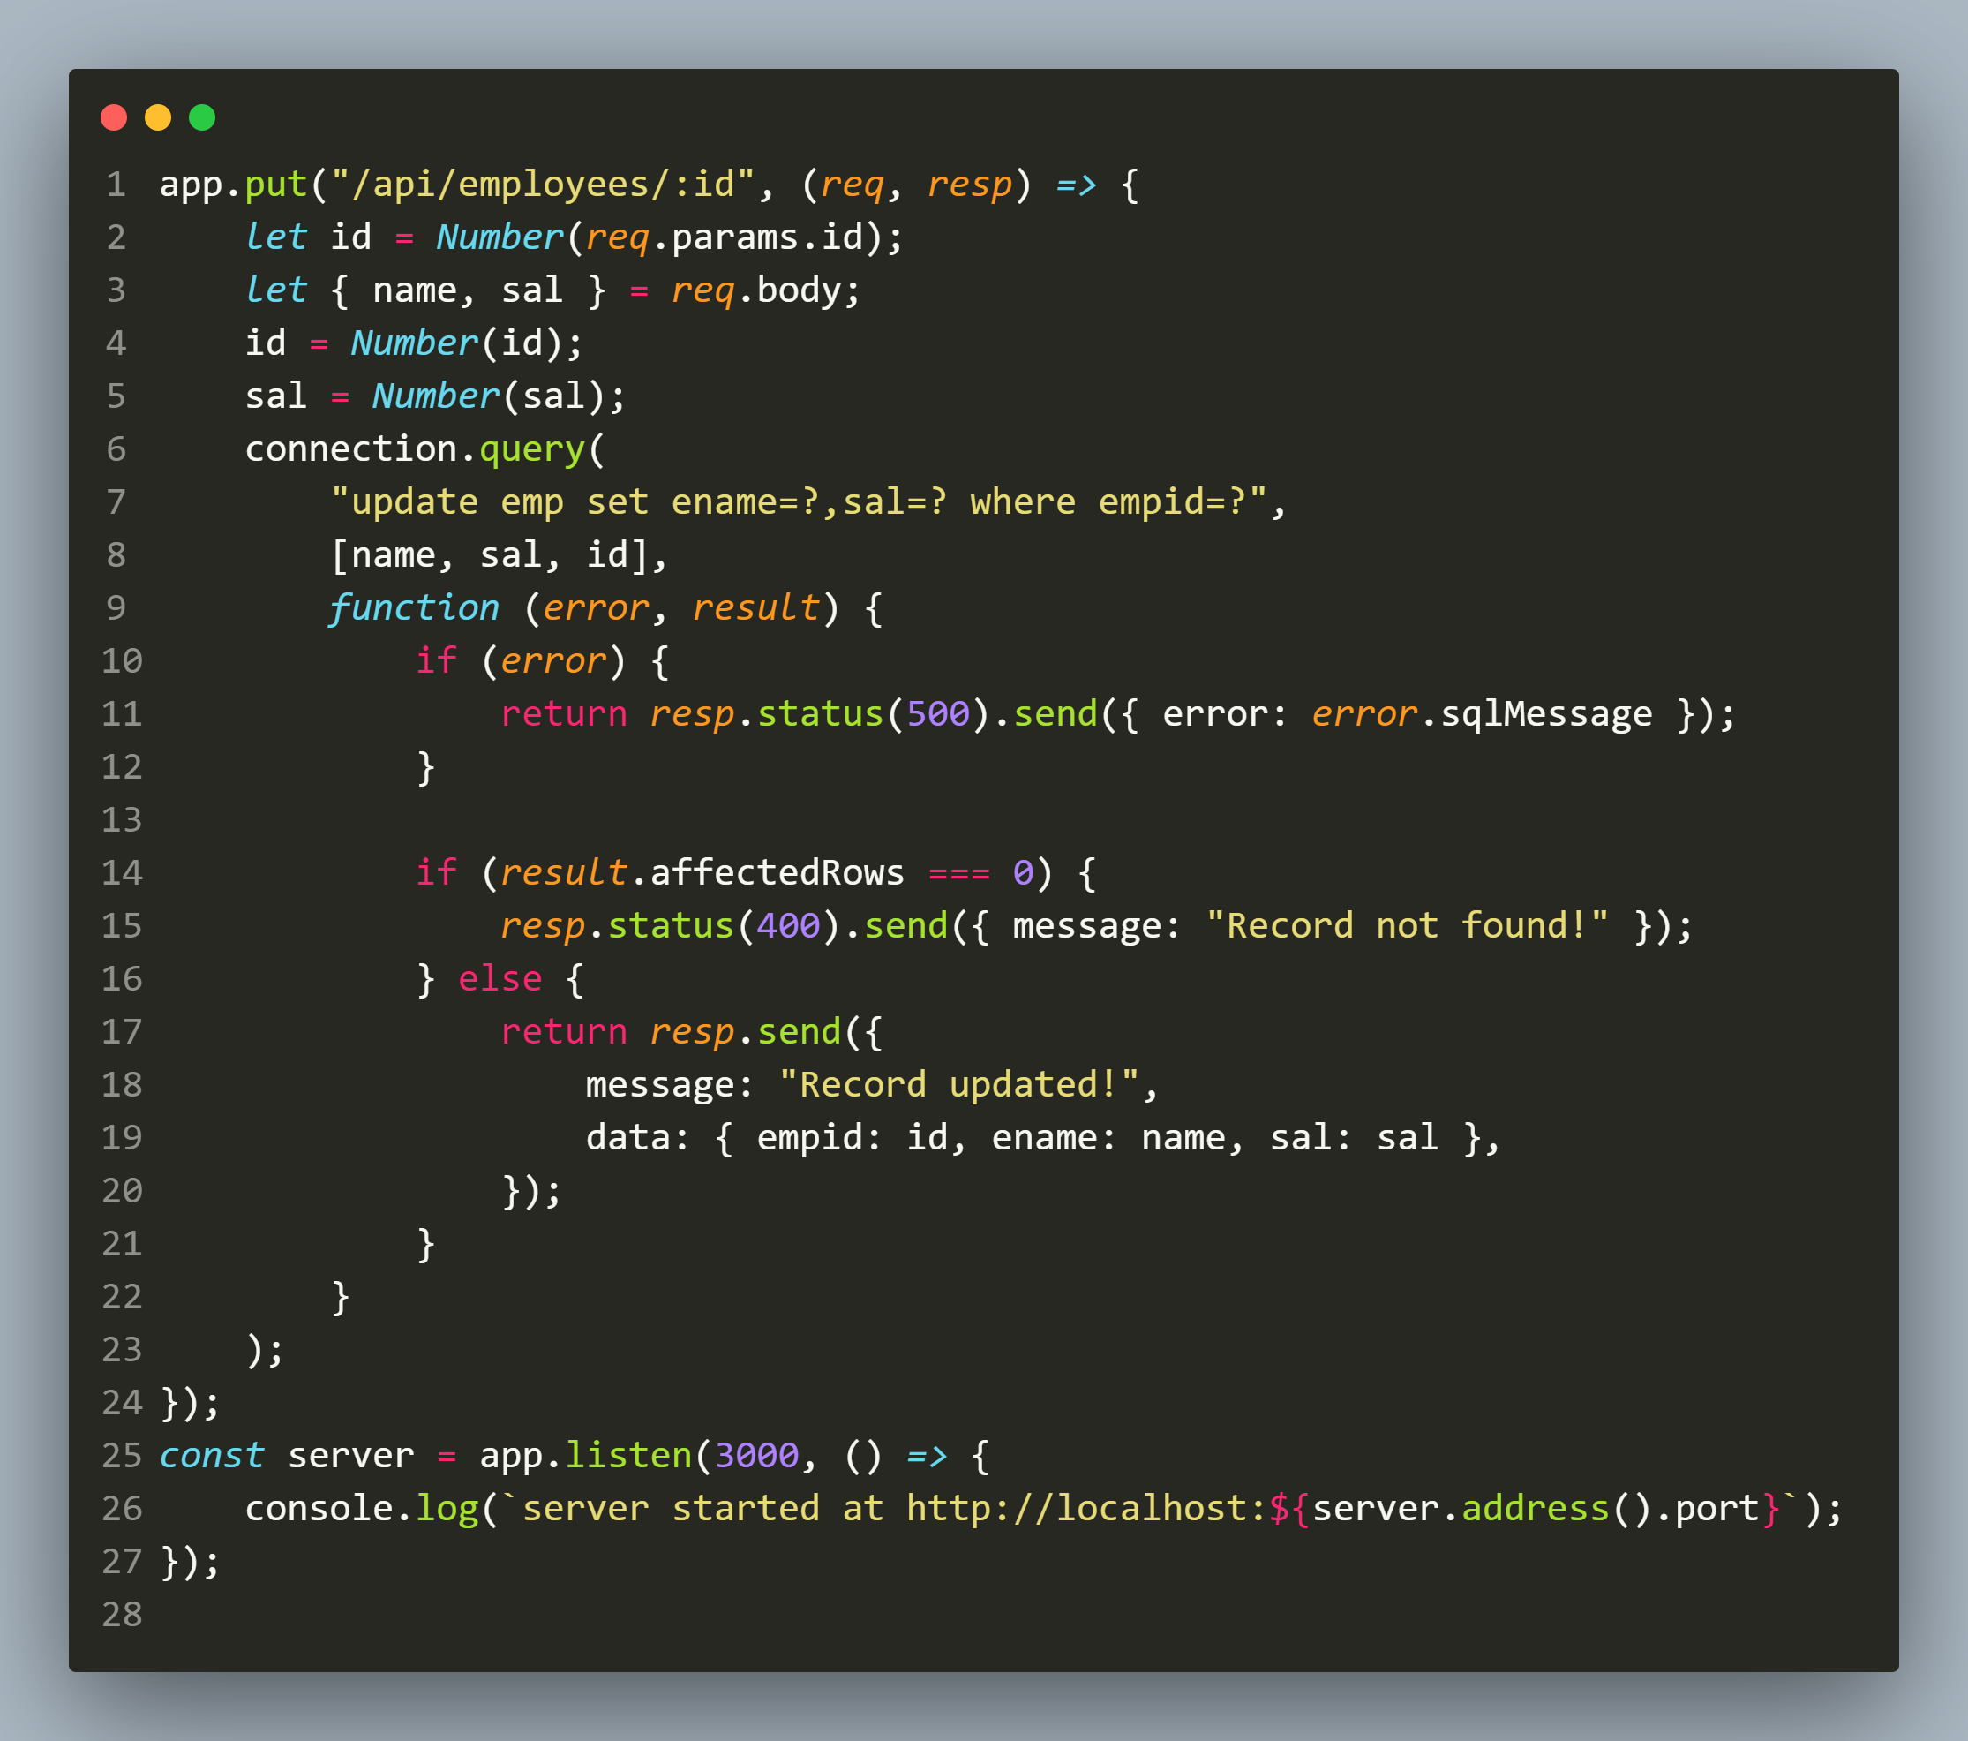
solution

Slide 37
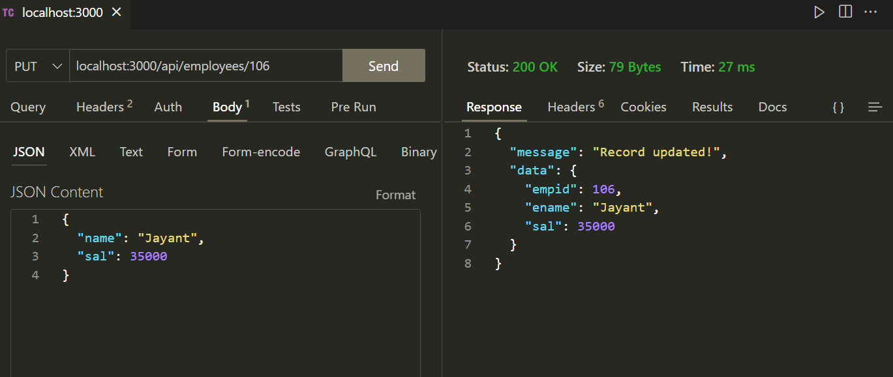
output

Slide 38
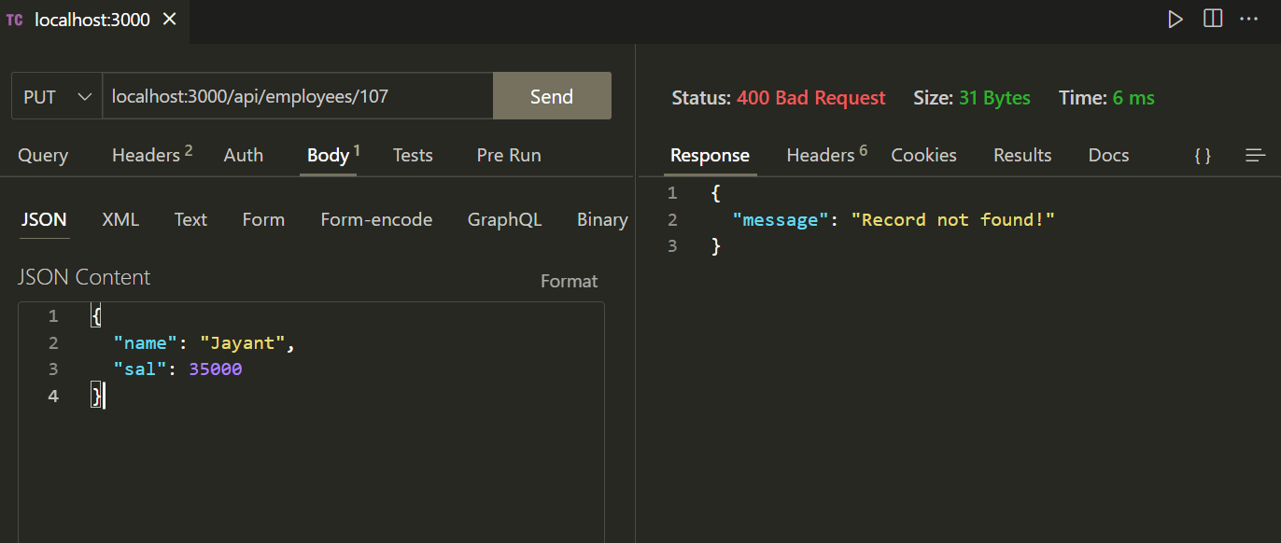
output

Slide 39
deleting record
The steps to delete a record are same as updating a record.
Here also if the values are dynamic then we can use placeholders.
To obtain number of rows effected we can use the affectedRows property of the object we get back as a response from db.

Slide 40
Exercise 67
Write an Expresss-EJS application for updating an employee as follows:
Your application should accept an employee id through a DELETE request and delete the record of that employee from the Emp table.
Finally it should return a JSON object containing id of the deleted record or 400 error if record is not found.

Slide 41
solution

Slide 42
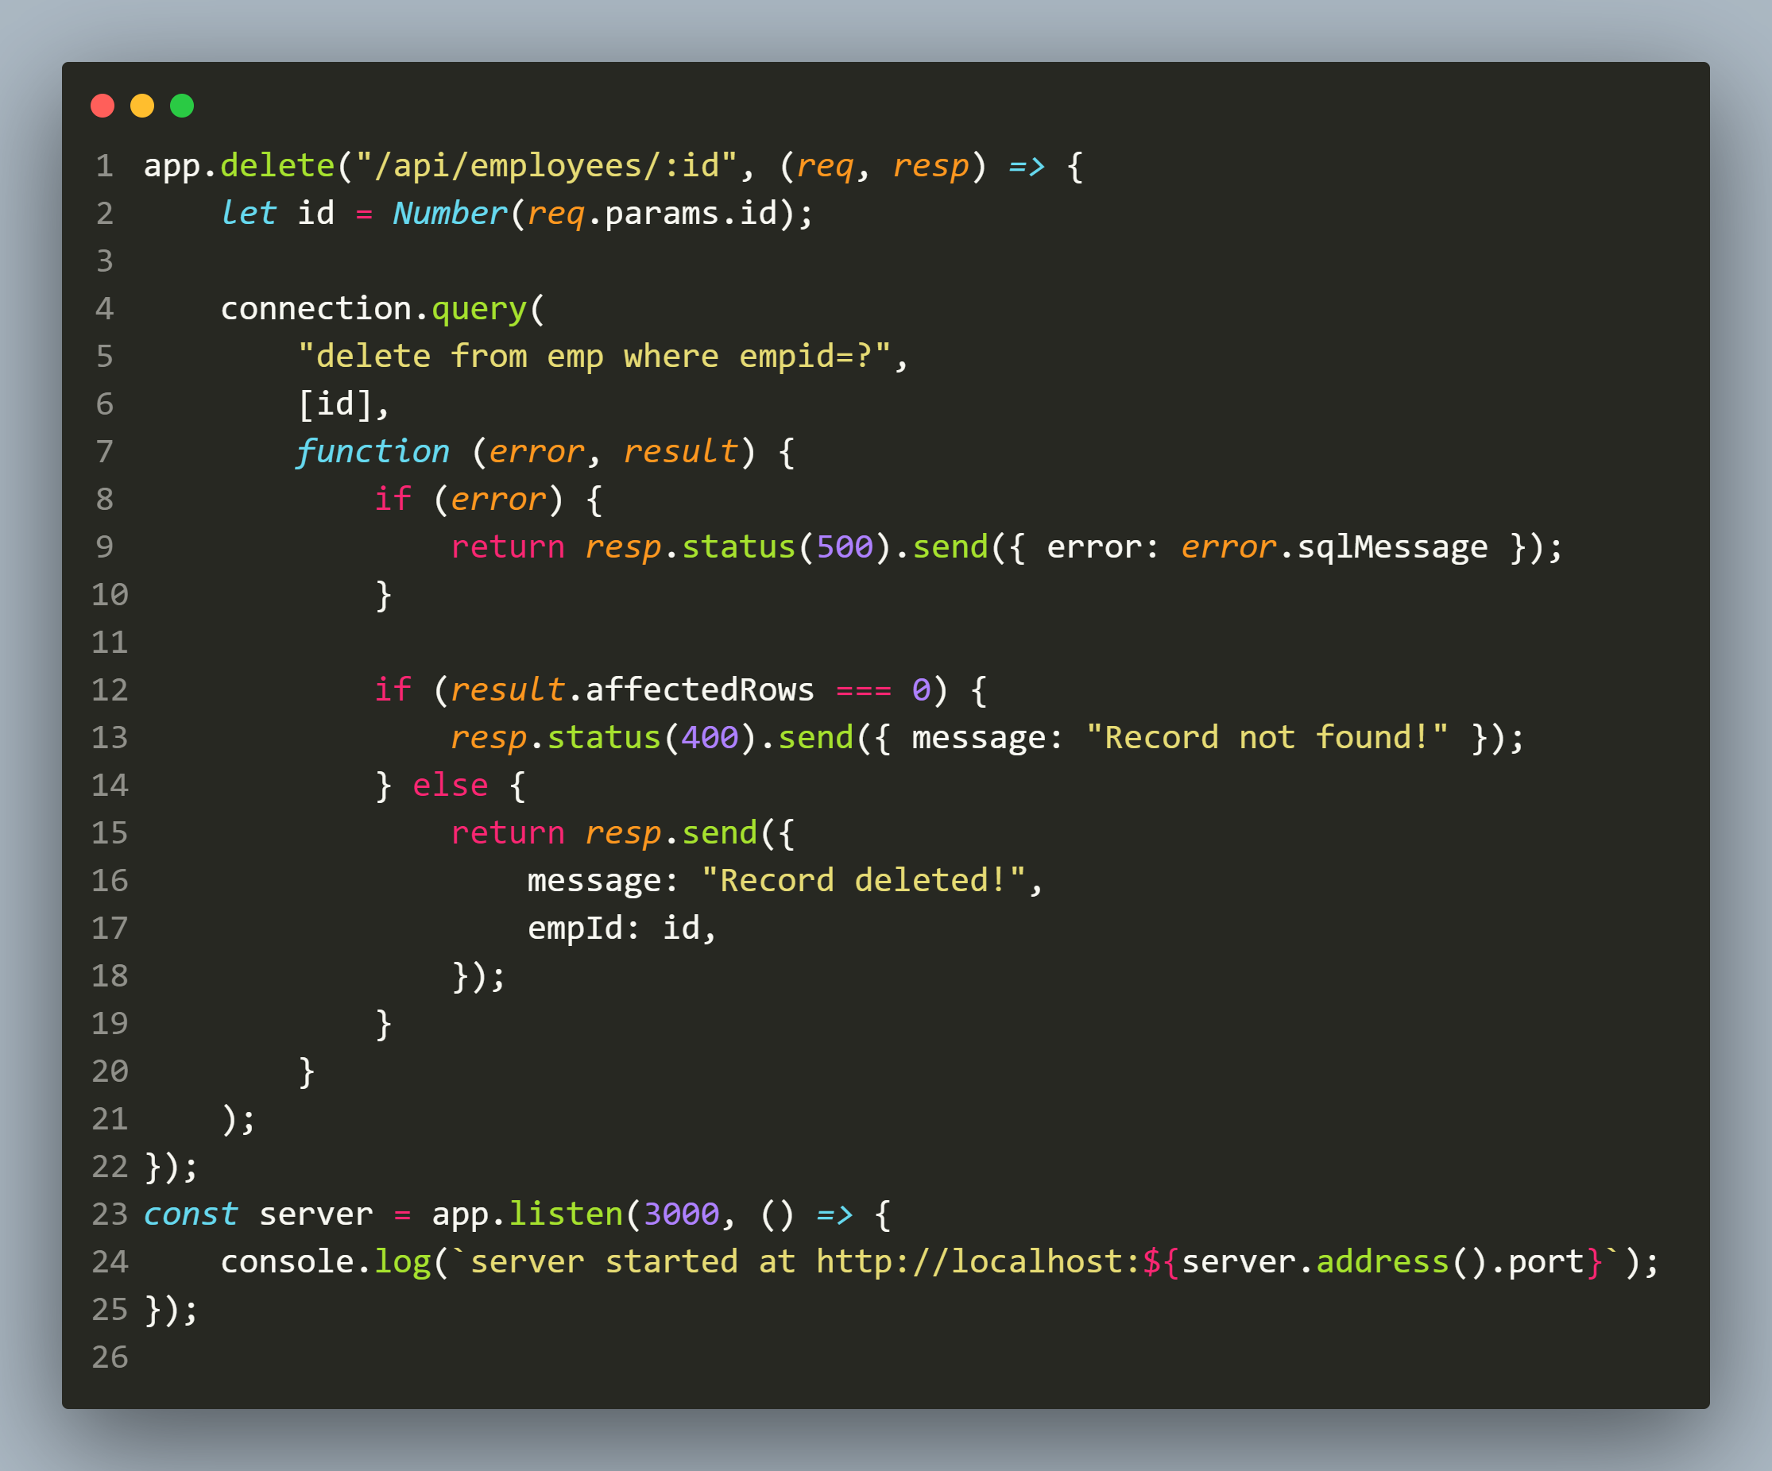
solution

Slide 43
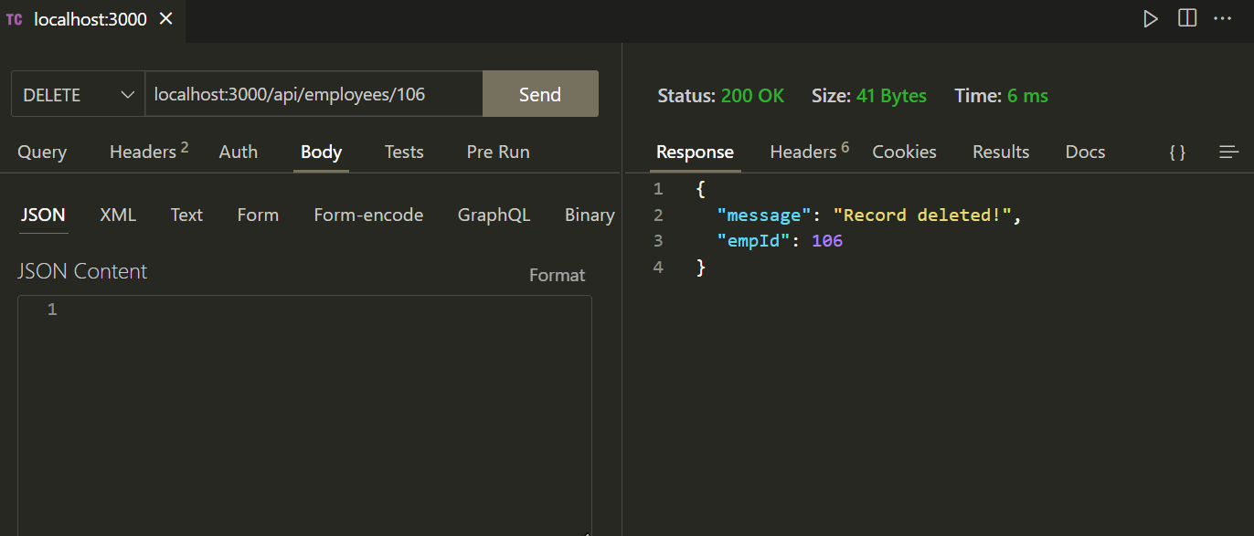
output

Slide 44
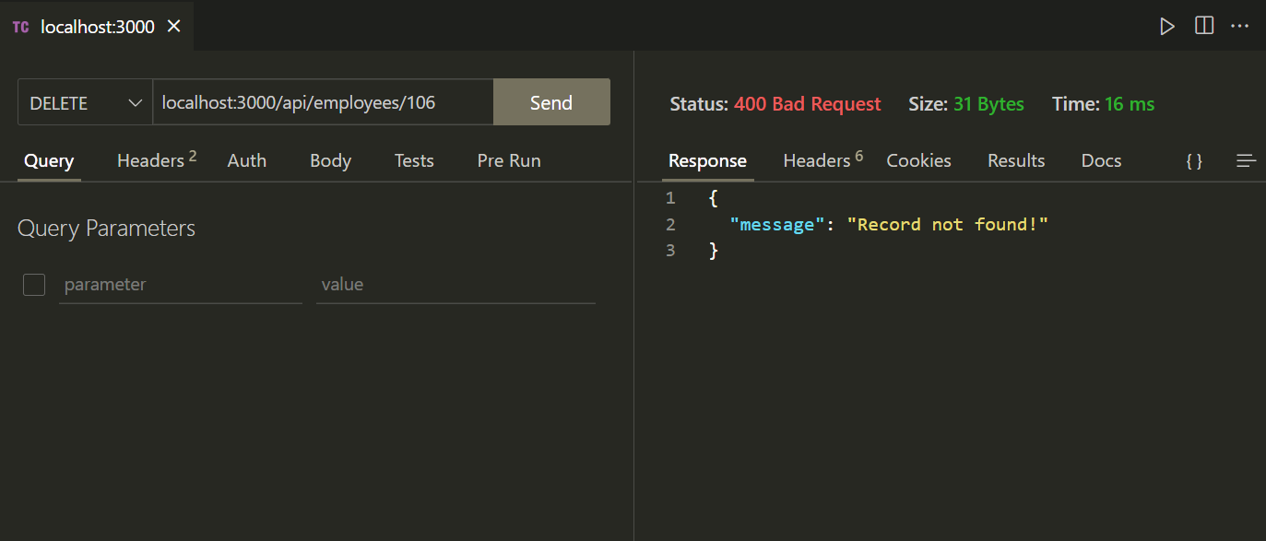
output

